Slide 1
Master’s Project
Research Question
Is there evidence for spontaneous recall during semantic retrieval?
Repeated Fluency Task
Semantic fluency task where category trials are repeated
Manipulating order and spacing of repetition trials
Analyses traditionally conducted on episodic retrieval data → applied to semantic fluency data

Slide 2
Semantic Fluency Tasks
Semantic Fluency Tasks
Used to evaluate integrity of semantic memory
Category prompt → asked to list as many items as possible
Performance Outcomes
Cognitively healthy performance hallmarked by
Items clustered by proximity of association
Grouped within subcategories or by shared attributes
Strategic searches after exhausting available information from a cluster
Notes:
Searches occur both locally when exploiting a particular

Slide 3
Semantic Fluency Tasks
Performance Outcomes Continued
Global transitions tend to occur when available information within a cluster is depleted (Hills, Todd, & Jones, 2015)
Transitions tend to be guided by semantic priming from existing retrievals (Hills, Jones, & Todd, 2012)
Semantic priming → processing one word facilitates subsequent retrievals for targets close in semantic proximity (Meyer & Schvaneveldt, 1971)

Slide 4
Evidence for Semantic Organization in Episodic Retrieval
Commonly studied in Free Recall
Retrieved items clustered by meaning
(Manning & Kahana 2012)
Deese-Roediger-McDermott (DRM) Paradigm
Free recall lists sharing a common theme often yield semantically relevant intrusions
(Deese, 1959; Roediger & McDermott, 1995)

Slide 5
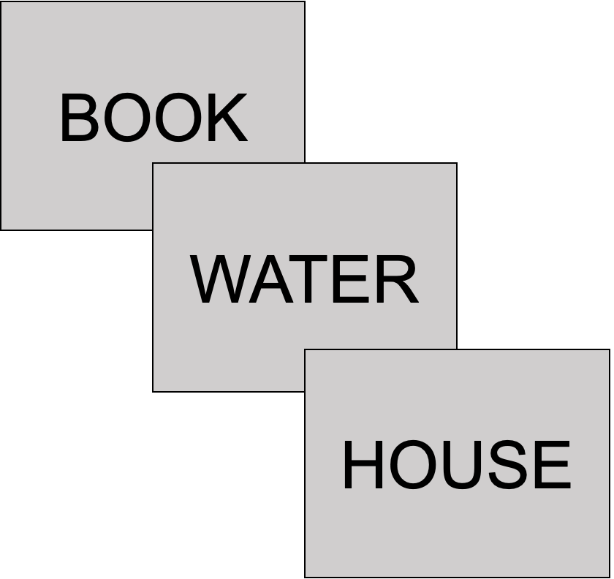
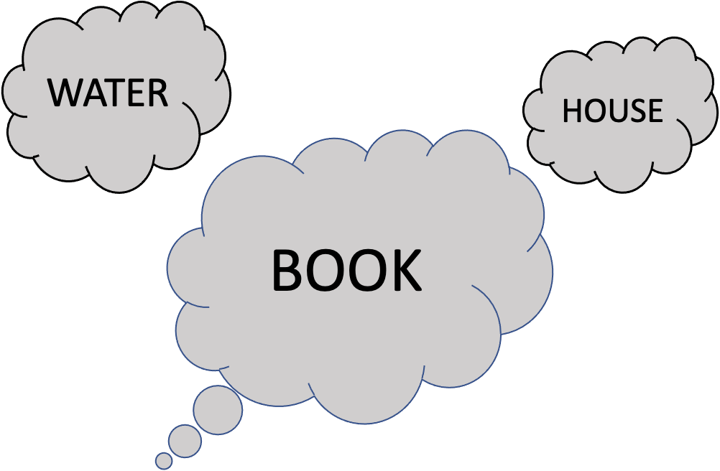
Episodic Representations During Retrieval

Slide 6
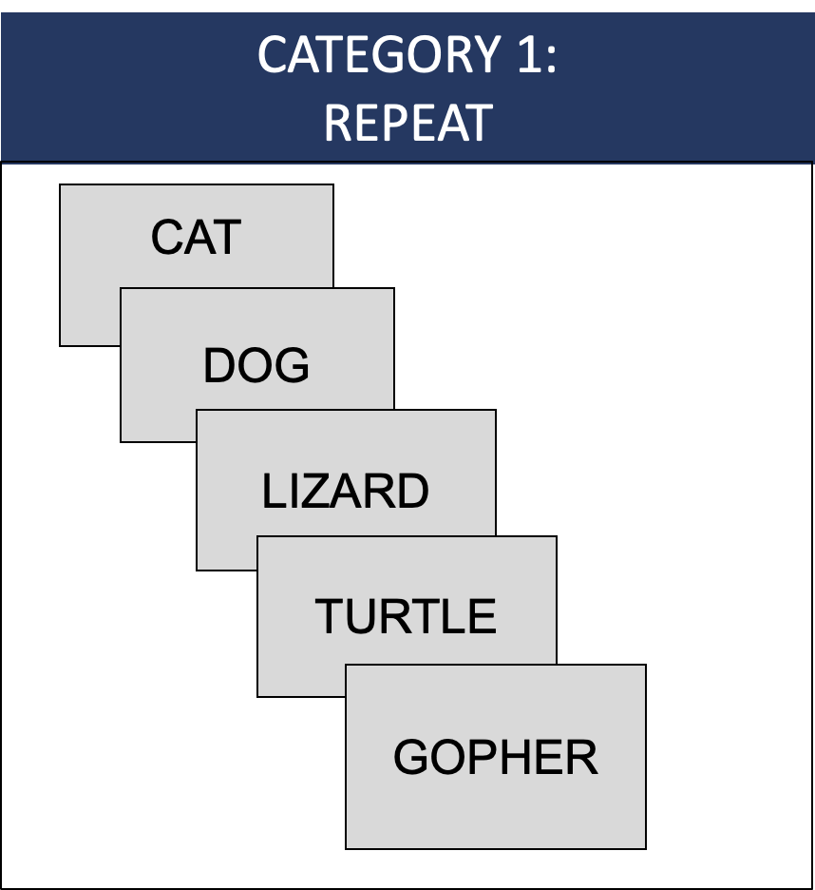
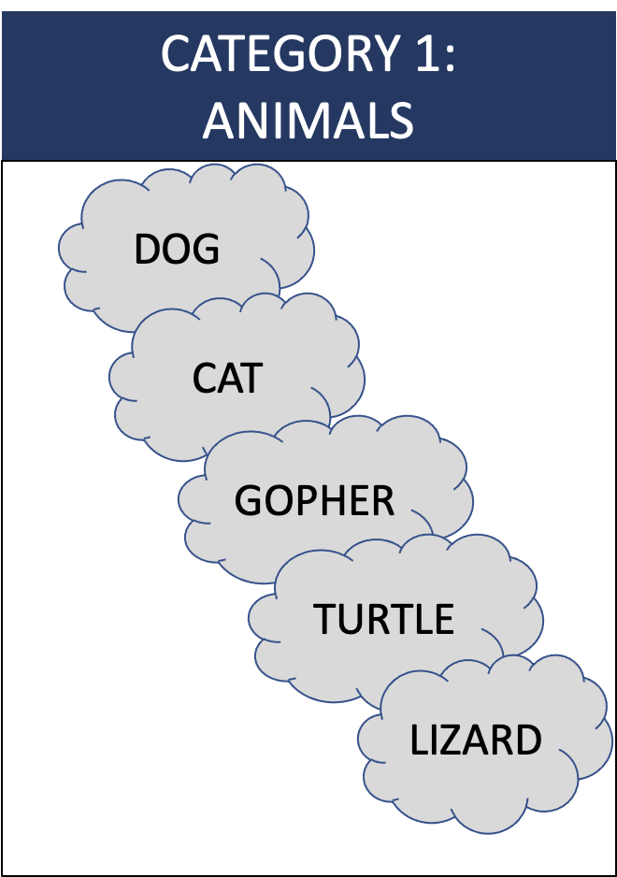
Episodic Representations During Retrieval

Slide 7
Repeated Fluency Task Format
Novel category prompts interleaved with repeated trials
Trial A
Trial D
Trial C
Trial B
Trial C
Trial B
Trial A
Trial D

Slide 8
Comparisons
Maintaining transitions
Probability of recalling two adjacent items on initial and repeated fluency trial
e.g., Probability of CAT and DOG appearing in adjacent output positions for both repeated fluency trials
Maintaining transition order
Probability of CAT preceding DOG in both the initial and repeated fluency trial
e.g., Initial Fluency (CAT-DOG) → repeated fluency (CAT-DOG) and not (DOG-CAT)
Traditional

Slide 9
Comparisons
Traditional Episodic Memory Effects
Serial Position Curve for semantic fluency trials
Spacing effects
Accounting for typicality → How frequently is an item listed, regardless of temporal spacing?

Slide 10
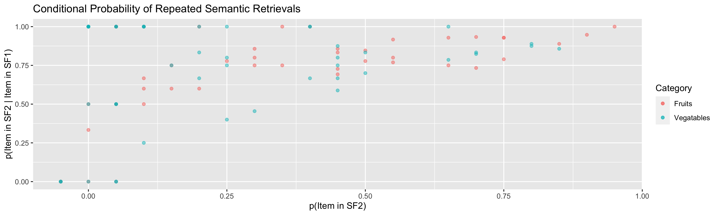
Preliminary Comparison

